Slide 1
Final Engagement
Attack, Defense & Analysis of a Vulnerable Network
Notes:
Introduction to breakroom 2 also famously known as FUBAR

Slide 2
Table of Contents
This document contains the following resources:
Network Topology & Critical Vulnerabilities
Exploits Used
Methods Used to Avoiding Detect

Slide 3

Network Topology
& Critical Vulnerabilities
‹#›

Slide 4
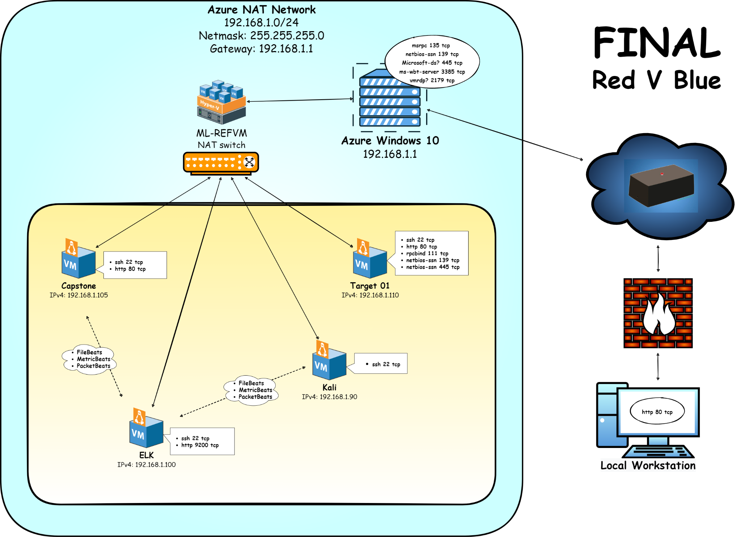
Network Topology
Network
Address Range: 192.168.1.0/24
Netmask: 255.255.255.0
Gateway: 192.168.1.1
Machines
IPv4: 192.168.1.1
OS: Windows 10
Hostname: Azure Windows 10
IPv4: 192.168.1.90
OS: Linux
Hostname: Kali
IPv4: 192.168.1.100
OS: Linux
Hostname: ELK
IPv4: 192.168.1.105
OS: Linux
Hostname: Capstone
IPv4: 192.168.1.110
OS: Linux
Hostname: Target1
Notes:
Li
Point out the pathway and a brief of each machine function

Slide 5
Critical Vulnerabilities: Target 1
Our assessment uncovered the following critical vulnerabilities in Target 1.
Vulnerability | Description | Impact
Open Ports | Nmap port scan was not blocked which then revealed several open ports | Used open port 22/tcp (ssh) and open port 80/tcp (http). Gained access to Target1 by ssh.
Root Privilege Escalation | Python scripting enabled for user Steven | Spawned interactive terminal on Target1 & gained root access
Weak Password Policy | Hydra password spraying attack to brute force a user’s known wordlist rockyou.txt. and John the Ripper against found unsalted hashes. | Hydra was able to discover the password for Michael, and John the Ripper cracked Steven’s Password
WPScan to Enumerate the Users of the Targeted Wordpress Site | Ran WPScan against 192.168.1.110/wordpress wpscan —url http://192.168.1.110/wordpress —enumerate u | Exposed Wordpress vulnerabilities and discovered users Michael and Steven
Notes:
Ian (¾) and Matt (½)
We used Nmap port scan on 192.168.1.110 or known as target one, to identify open ports, as Nmap was not blocked. The Open ports we found were 22/tcp for SSH and Open port 80/tcp for http. This allowed us to ssh in and gain access to Target 1 by using the command ‘ssh michael@192.168.1.110’
For Root Privilege Escalation we gained access to Steven’s account, we then discovered that Python scripting was enabled. This allowed us to spawn a interactive terminal and gain root access.
Running THC Hydra which runs a rapid dictionary attack attack against more than 50 protocols, and ideal for remote unauthorized access testing. This is run against the wordlist Rockyou.txt by searching weak Unix passwords from a file of over 14 million passwords. In honestly, we were also to first guess Michael’s password by simply guessing it. Our third guess was successful which you have likely eluded any lockout policies in place as well.
WPscan. A Kali Linux default installation reconnaissance tool that allows us to pull information about the server running Wordpress. We ran simple passive commands that revealed active directory listing that was enabled within Apache. From here we could see the two users that we would be looking to compromise.

Slide 6
Exploits Used
‹#›

Slide 7
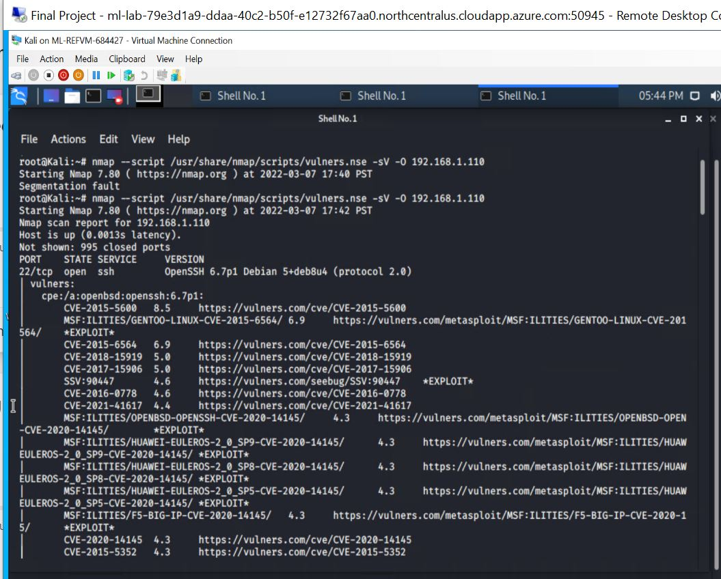
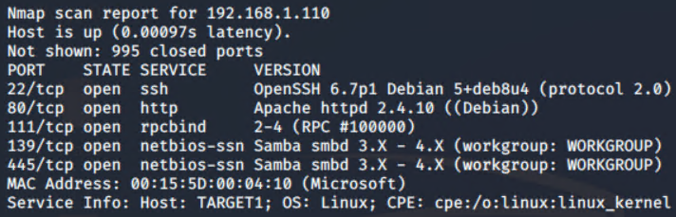
Exploitation: Port Scanning
We used a Nmap scan to scan the network for open ports on each available machine.
We are able to see accessible ports that we can use for an attack. Port 22 is open on the Target 1 machine which allowed us to ssh (Secure Shell protocol) into the machine. Port 80/tcp (http) was also open.
Target 1 Nmap:
Notes:
Nick Peterson & Mahendra

Slide 8
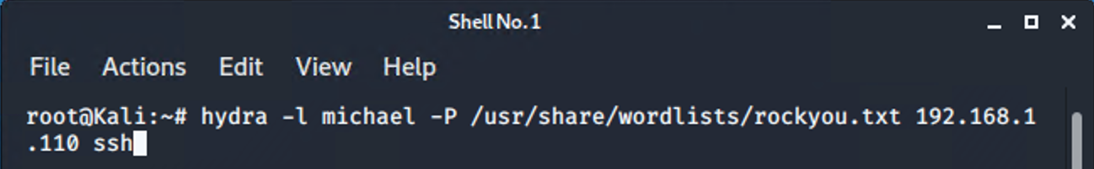
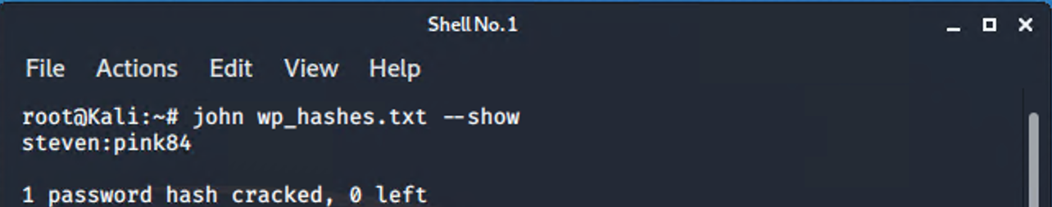
Exploitation: Weak Password Policy
Used THC Hydra to execute a brute force attack against Michael’s password
Used john the ripper to crack Steven’s unsalted password hash
Gained access to Michael & Steven’s accounts
Hydra command results & John command results
Notes:
Mallory – (John) & Jacquie -(Hydra)
We were able to use a the dictionary password cracker, Hydra, to discover Michael’s password within the rockyou.txt dictionary file. After finding unsalted hashes for Michael and Steven in the wp_users table of the wordpress mysql database we were able to create a wp_hashes.txt file and then run John the Ripper against the hashes. The results gave us Steven’s password – pink84. With his password, we were able to access his account and find flag 4.

Slide 9
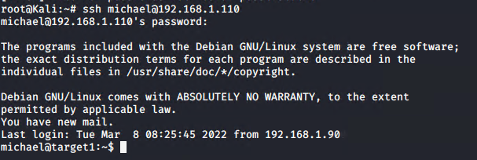
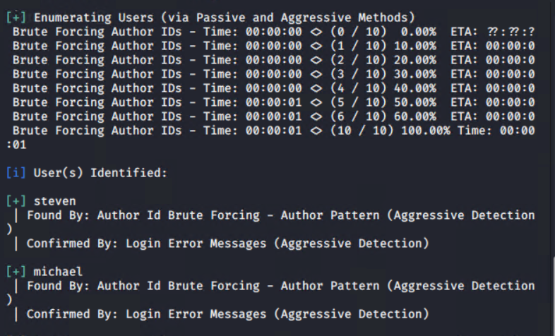
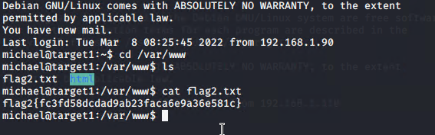
Exploitation: Enumerating Users
Passive and aggressive methods using WordPress Security Scanner (WPScan)
Using IDs and password we used ssh michael@192.168.1.110 to gain access to the user’s root access
Notes:
Ikram and Ian
As mentioned before, using a simple passive and aggressive WPScan against the URL we are able to crawl the wordpress site to find information about active users through an enabled directory listing, a Wordpress version, and server being used. It is possible to use more aggressive WPScans by grabbing an API token from the WPScan website to scan for known vulnerabilities with this Wordpress site.

Slide 10
Avoiding Detection
‹#›

Slide 11
Stealth Exploitation of Open Ports
Monitoring Overview
Which alerts detect this exploit? HTTP Request Size Monitor & CPU Usage Monitor
Which metrics do they measure? HTTP Request Size Monitor measures packetbeat input, CPU Usage measures metricbeat input.
Which thresholds do they fire at? HTTP Request Size Monitor threshold fires if greater than 3500 events in the last 1 minute, CPU Usage Monitor threshold fires if CPU runs over 50% in the last 1 minute.
Mitigating Detection
How can you execute the same exploit without triggering the alert? Perform the scan over longer period of time or perform with multiple computers to avoid HTTP Request Size Monitor and CPU Usage thresholds being met.
Are there alternative exploits that may perform better? Nmap using Tortunnel via proxychains
Notes:
Mahendra & Ian

Slide 12
Stealth Exploitation of WordPress
Monitoring Overview
Which alerts detect this exploit? HTTP Request Size Monitor
Which metrics do they measure? Bytes being requested
Which thresholds do they fire at? >3500 bytes for the last 1 minute
Mitigating Detection
How can you execute the same exploit without triggering the alert? Run a wpscan with flag --throttle to adjust time to run scan or --stealthy to change detection mode to passive
Are there alternative exploits that may perform better? wp_enum for the discovery of wordpress user and accounts
Notes:
Salad & Arthi

Slide 13
Stealth Exploitation Weak password policy
Monitoring Overview
Which alerts detect this exploit? Excessive HTTP Errors
Which metrics do they measure? HTTP Response Status Codes
Which thresholds do they fire at? When HTTP status code is 400+ for the last 5 minutes
Mitigating Detection
How can you execute the same exploit without triggering the alert? Guess and check methods due to Michael’s name ‘michael’ being the password
Are there alternative exploits that may perform better? SSL Hijacking, Beef hook, Dirsearch
Notes:
Bonssa & Jim

Slide 14
F B R Collaboration
Project was created and completed as a team project by:
Ian Stanford
Nick Peterson
Matt Carraher
Mahendra Lall
Jim Lund
Bonssa Teizazu
Ikram Osman
Li Harmon
Jacquie Kerongo
Mallory Wald
Salad Abagira
Arthi Baskar
University of Minnesota Cyber Security Bootcamp
Group 2 (FUBAR)

Slide 15
The End

